Slide 1

OBJECT-ORIENTED PROGRAMMING
FORCES 2D
SIMUTATION
GROUP 22
Supervisor: Mr. Tran The Hung

Slide 2
OVERVIEW
INTRODUCTION
PROBLEM
CLASS DIAGRAM
OOP PRINCIPLES
DEMO
THANK YOU

Slide 3
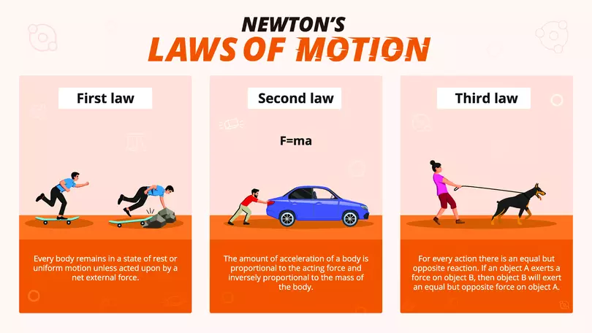
Develop an application to simulate the effect of a force acting on an object according to Newton's Law of Motion. The program should allow users to input the mass of the object and the applied force, then calculate and display the resulting acceleration. Additionally, visualize the object's motion over time under the influence of the applied force.
PROBLEM

Slide 4
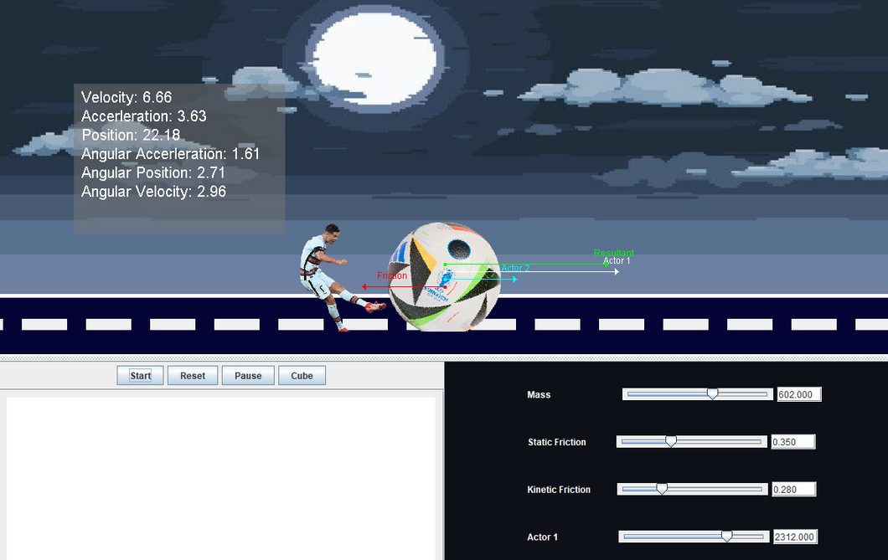
APPLICATION INTRODUCING
MAIN USES
Our Java project aims to demonstrate Newton's Second Law of Motion through a dynamic simulation. By entering the mass of an object and the force applied to it, users can observe the resulting acceleration and track the object's movement over time. This interactive tool helps in understanding the fundamental principles of physics in an engaging manner.

Slide 5
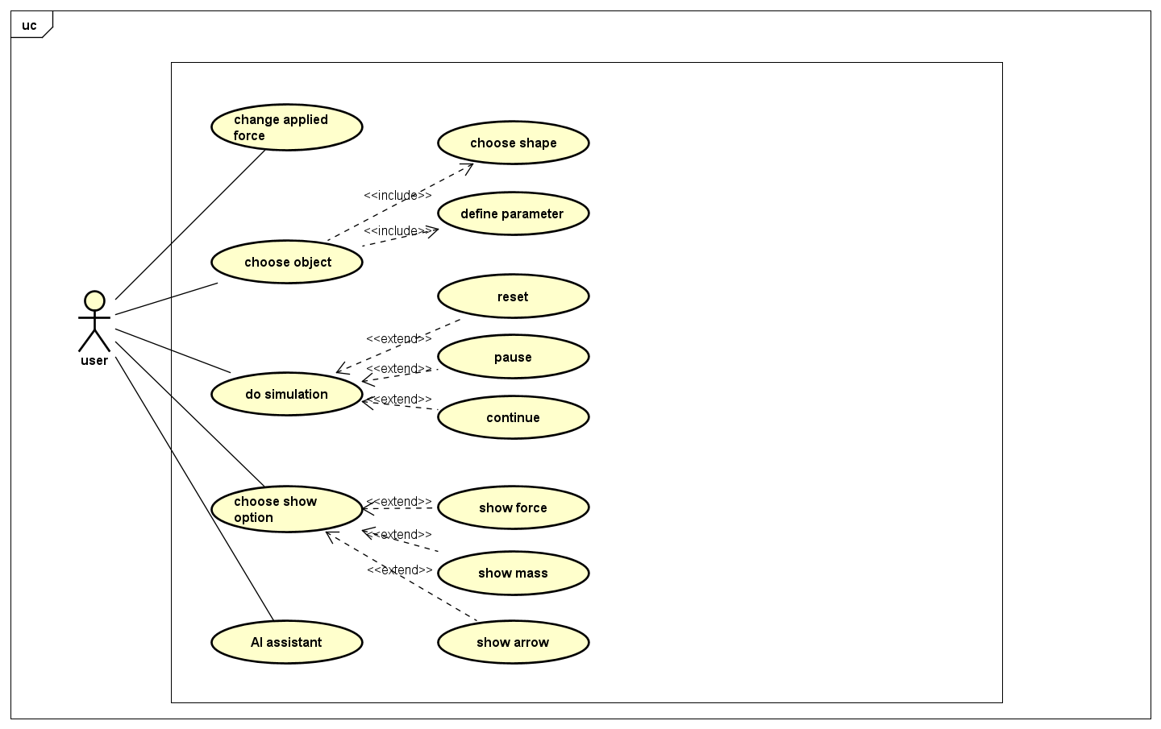
USES CASE

Slide 6
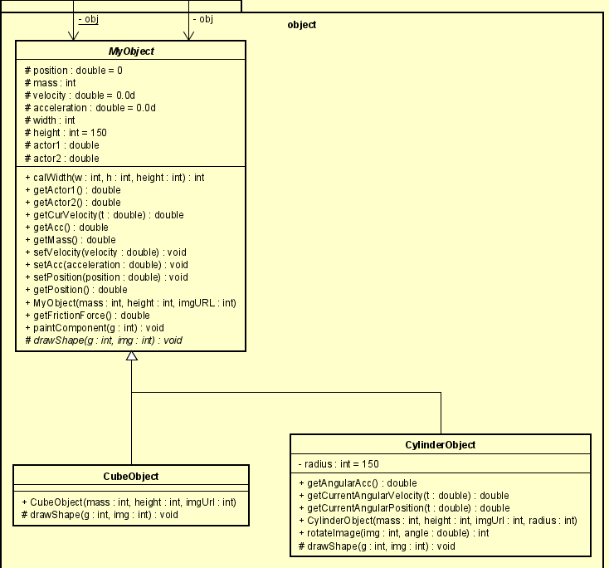
CLASS DIAGRAMS

Slide 7
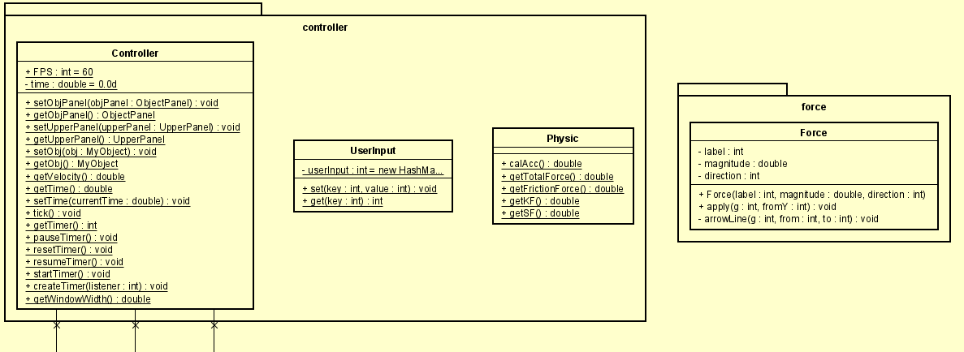
CLASS DIAGRAMS

Slide 8
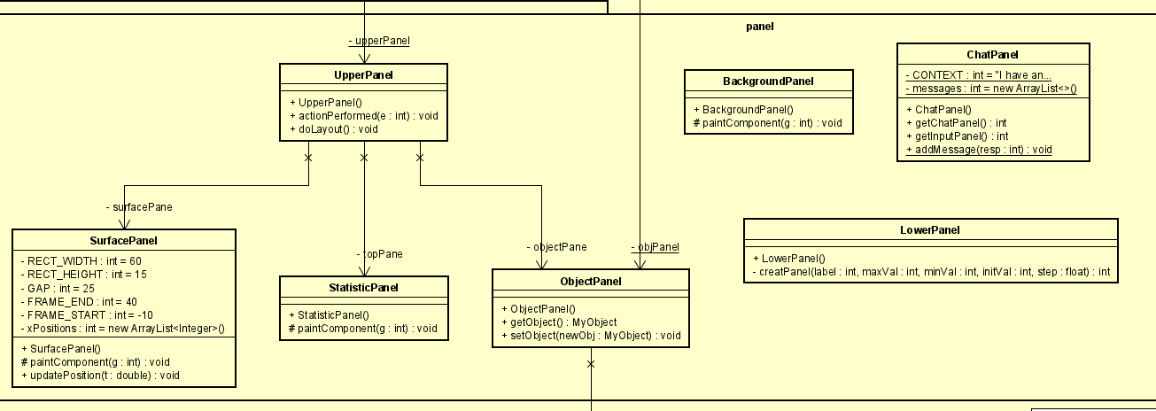
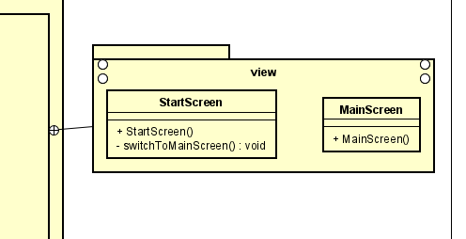
CLASS DIAGRAMS

Slide 9
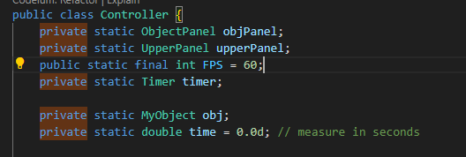

OOP PRINCIPLES IN PROJECT
ENCAPSULATION
Encapsulation is the process of bundling data (attributes) and methods (functions) that operate on the data into a single unit known as an object. This helps to hide the internal state of the object and only expose the necessary parts of the interface. Users interact with the object through its public methods without needing to understand the internal workings.
EXAMPLE
BY CLAUDIA ALVES

Slide 10
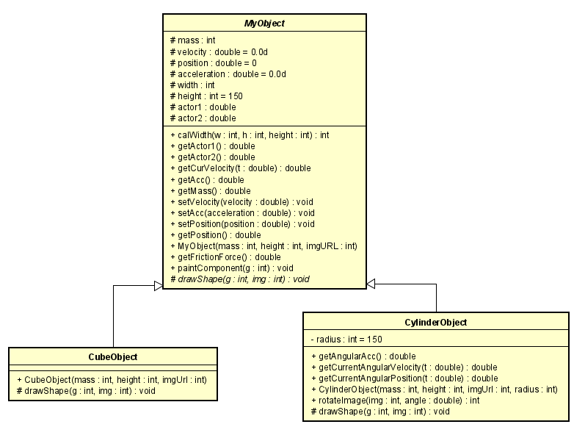
OOP PRINCIPLES IN PROJECT
INHERITANCE
EXAMPLE
Inheritance allows the creation of new classes based on existing classes.
The new class, called a subclass, inherits attributes and methods from the existing class, known as the superclass.
This promotes code reuse, reduces redundancy, and enhances the extensibility of the program.
BY CLAUDIA ALVES

Slide 11

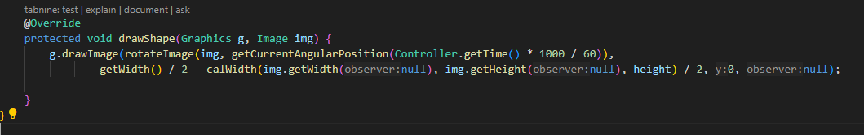
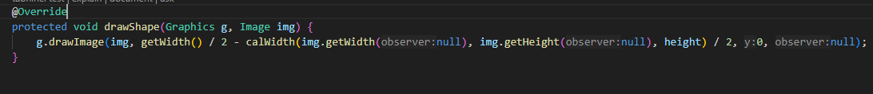
OOP PRINCIPLES IN PROJECT
POLYMORPHISM
EXAMPLES
Polymorphism enables objects of different classes to be treated as objects of a common superclass. It allows the same method to behave differently based on the object it is called on.
Polymorphism can be achieved through method overloading and method overriding, providing flexibility and enhancing the program's extensibility.
BY CLAUDIA ALVES

Slide 12
OOP PRINCIPLES IN PROJECT
ABSTRACTION
EXAMPLE
Abstraction involves hiding complex implementation details and showing only the essential features of an object. It simplifies the management of complex systems by allowing the user to interact with the object at a higher level. Abstract classes and interfaces are tools used to achieve abstraction in OOP.
BY CLAUDIA ALVES

Slide 13
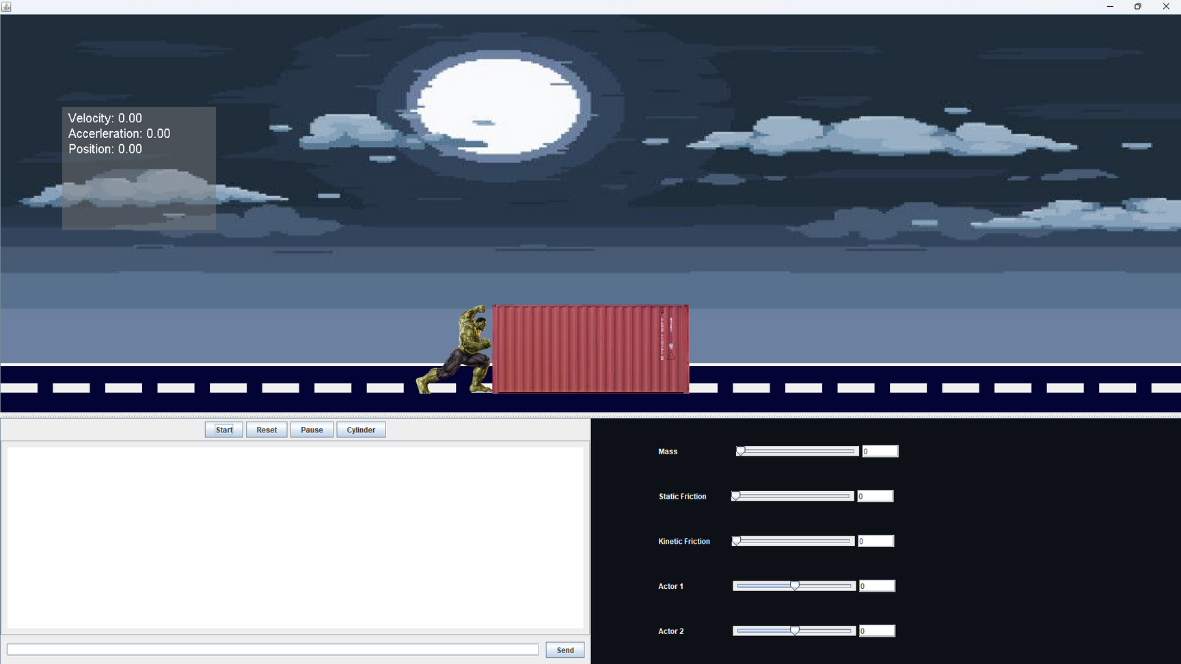



APPLICATION PREVIEW
UPPER PANEL
LOWERPANEL
CHAT PANEL

Slide 14
DEMO

Slide 15

In this project, we successfully simulated forces acting on objects in a two-dimensional space using Java, with AI integration to enhance accuracy and realism. The core objective was to create a dynamic environment with realistic physical interactions, such as gravity and collisions. AI improved the system's responsiveness and efficiency by predicting complex interactions. This project deepened our understanding of physics simulations and AI integration, demonstrating the potential for advanced computational techniques to model real-world phenomena accurately. The results provide a solid foundation for further research and development.
Project conclusion
CONCLUSION

Slide 16
RECOMMENDATIONS
RECOMMENDATIONS 01
RECOMMENDATIONS 02
Implement unit testing to ensure the accuracy and reliability of force simulations.
Integrate a user-friendly graphical interface to visualize object interactions dynamically.

Slide 17
THANK YOU

